Slide 1

IMPACT OF PRETRAINING MODELS ON VISUALIZING HEALTH DATA​
- Afamefuna Umejiaku ​
- Himaja R Thatiparthi ​

Slide 2
Introduction
Free-text Clinical notes contain information of patients which are unstructured and consists a language very specific to the medical domain.
Word Embeddings are used to extract knowledge from these Notes.
In this paper, we visualize the impact of some of the most common word embedding techniques to argue that the effectiveness of the techniques when used in training unstructured data from sources other than the health sector might not be same with that of the health sector due to the unique nature of health data.

Slide 3
Word Embeddings
Word Embeddings are texts converted into numbers, and there can be distinct numerical representations of the same text.
This numerical word representation can be used to map each word in a vocabulary to a point in a vector space.
Word embeddings are an improvement over the bag-of-word model word encoding schemes like word counts and frequencies which represents documents as a bag of its words, ignoring the grammar and even word order.

Slide 4
Word Embeddings
Word Embeddings can further be classified as
Static embedding
Dynamic embedding

Slide 5
Static Embedding
Static Embeddings cannot differentiate the semantic disparity among same word appearing in different contexts.
Some of the static embedding techniques are:
Word2Vec
Glove
fastText

Slide 6
Word2Vec
Word2vec is a cluster of related models that are employed to produce word embeddings.
Word2vec algorithm learns word associations from a large amount of text using a neural network model.
It represents each distinctive word with a specific list of numbers called a vector.
This can be obtained using two methods:
Skip Gram
Common Bag Of Words (CBOW).

Slide 7
Doc2Vec
Doc2Vec is an extension to Word2Vec such that Doc2Vec aims at learning how to project a document into a latent d-dimensional space.
This can further be classified into two models:
Paragraph Vector-Distributed Memory (PV-DM) model.
Paragraph Vector-Distributed Bag of Words (PV-DBOW).

Slide 8
GloVe
GloVe also known as Global Vectors for Word Representation is an unsupervised learning algorithm used to create word embeddings.
A co-occurrence information matrix is constructed, where the rows of the matrix depicts each word used in a context, and the columns represent the frequency of the words appearing in the context.
GloVe can be used to find relations among words like synonyms, company-product relations, cities, etc.

Slide 9
FastText
The FastText model builds on a specific limitation of traditional methods such as word2vec and GloVe. Specifically, that this model can handle out-of-vocabulary words
The main principle behind FastText is that the morphological formation of a word carries important information about the meaning of the word.
This can be achieved by viewing a word as a collection of sequences of adjacent characters or character-ngrams.

Slide 10
Dynamic Embeddings
Dynamic embeddings can effectively address this polysemy problem by representing the same word differently according to the context in which it appears.
Some of the dynamic embedding techniques are:
ELMO
BERT

Slide 11
ELMo
ELMo is a word embedding method used for representing a sequence of words as their subsequent sequence of vectors. ELMo word vectors are computed on a two-layer bidirectional language model (biLM).
Rather than a representing the dictionary of words and their corresponding vectors, ELMo analyses words within the context that they are used.

Slide 12
BERT
BERT stands for Bidirectional Encoder Representations from Transformers. It is designed to pre-train deep bidirectional representations from unlabeled text by jointly training on both left and right framework in all layers.
As a result, the pre-trained BERT model can be fine-tuned with just one supplementary output layer to create state-of-the-art models for a wide range of NLP tasks.

Slide 13
Implementation
Our implementation follows a few steps which enables us to effectively understand the impact of pretraining models on health data:
Data Pre-Processing
Feature Generation
Model training
Result Analysis

Slide 14
Data
The Data used was MIMIC-III (‘Medical Information Mart for Intensive Care’) a large, single-center database comprising information relating to patients admitted to critical care units at a large tertiary care hospital.
The Data includes vital signs, medications, laboratory measurements, observations and notes charted by care providers, fluid balance, procedure codes

Slide 15
Data Processing
Understanding the unique nature of our data set and the various models the dataset would be subject to, special steps were taken in the preprocessing than ordinarily adopted for other datasets.
Unique steps taken include converting all medical abbreviations to their fully original meanings, modifying the information extracted to represent the intended message and not how stored in Electronic health registers among others.

Slide 16
Steps for Data Preprocessing
Gather Data
Amend Data
Normalize Data
Stop-Words Removed
Tokenization
Stemming and Lemmatization

Slide 17
Steps – cont.
Gather Data:
The data was extracted from a csv file, that contained multiple rows representing information about a single patient. We used all the text available resulting in a very large file that none of the programs on our device could open hence we were only able to view it in bits using python.
Amend Data:
Algorithms developed to preprocess data for NLP tasks were not initially developed to handle health data. Hence, we manually looked for all the common medical abbreviations and converted all the abbreviations to their original words.

Slide 18
Steps – cont.
Normalize Data:
The next step was to normalize the data hence we converted all the words to lowercase so they can be easily treated. Next, we remove all the punctuations and finally all numbers, whitespaces, special characters and symbols were removed.
Stop-words Removed:
Here, we removed stop words such as “of”, “an”, ”a” etc., as the don’t give much information about context or relationships between entities. There is also no need for special care to handle medical abbreviations as there were already converted to their original format and hence, we simply used a NLP Library that contains a list of stop words by importing stop-words from nltk.corpus.

Slide 19
Steps – cont.
Stemming and Lemmatization:
Stemming a process of reducing inflection in words such as removing prefix and post-fix and returning root forms of words or canonical form of the original word was done. Lemmatization removes inflections, maps a word to its root form and tries to do it not just chop things off, but transforming words to their actual root word.
Tokens to Numbers:
The pretraining model requires that the tokens should be converted to integers to facilitate processing and could be converted back to text after processing. While Word2vec, fast-text and Glove all used same method, Elmo and BERT had special techniques defined in their libraries.

Slide 20
Model Training
The mentioned models were trained using the features that were generated while preprocessing.
The models were made to print their losses while training as this was one of the methods, we were going to evaluate the models
An effective way to evaluate the BERT model is by plotting a 1D loss curve and a 2D loss landscapes on a specific datasets.
Futher analysis was was performed to obtain more informationto enable us calculate the Davies-Bouldin Index or DunnIndex, which measures intra-cluster distance vs inter-cluster distance

Slide 21
Model Training – cont.
To ensure that a good picture could be extracted from the loss valves, they were all trained to 10 Epochs, but as would be observed in fine-turning BERT it was observed that we were likely over-fitting after the sixth Epoch as there were not much changes.
The Next step was to plot the loss values for each of the models trained. While implementing the techniques it we encountered difficulties implementing all our earlier selected models hence we did not implement ELMO and Fast-text as a result of limited time between getting the data and the deadline to generate report

Slide 22
Result Analysis
All the training was done on a single data set to ensure the were tested uniformly, the were also trained from beginning expect for BERT which were we only fined-turned to save time and transfer learning is easily applied.
The first experiment is to demonstrate that pre-training loss and using the Loss Function earlier defined, the start point indicates the training loss of the initialized model, while the end point indicates the final training loss.
It is observed that the losses are still quite high except for Bert hence more data and or more Epoch were required.

Slide 23
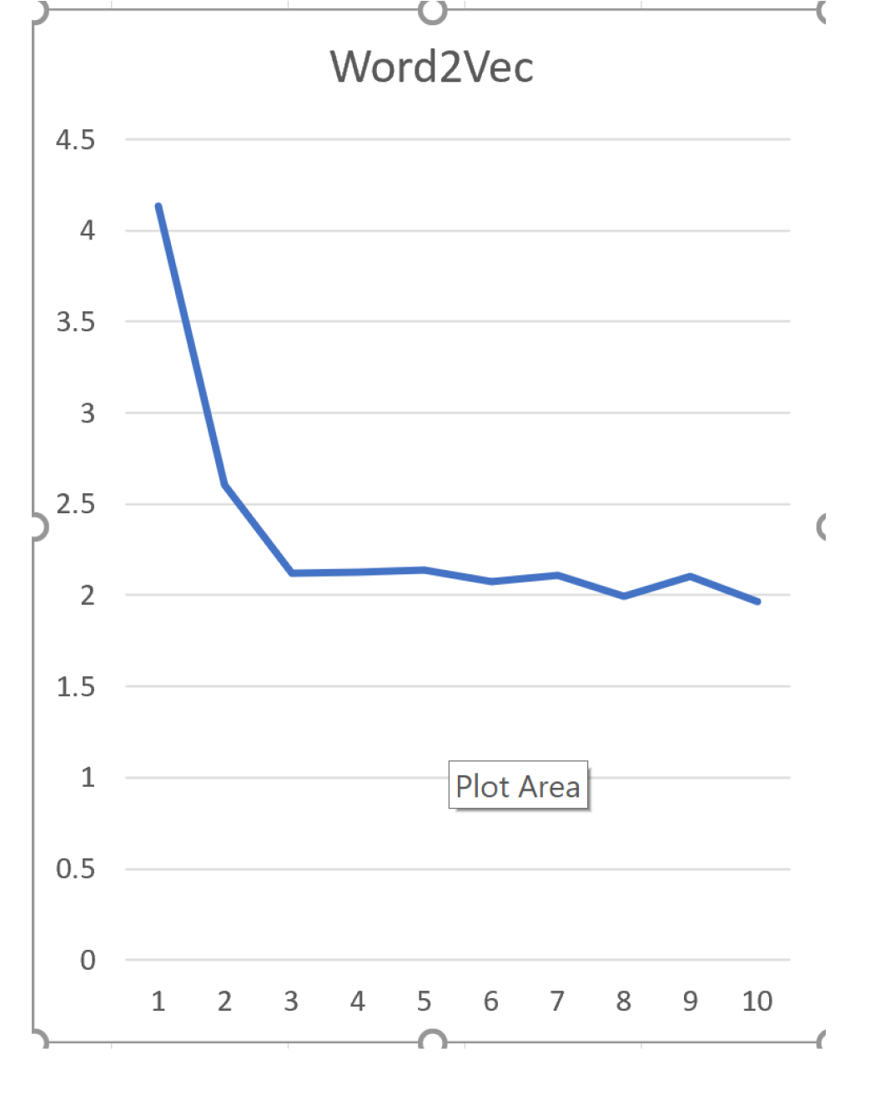
Result: Word2Vec
In the below figure, the learning curves are depicted by a line graph demonstrated using the Loss Function earlier defined for Word2vec.

Slide 24
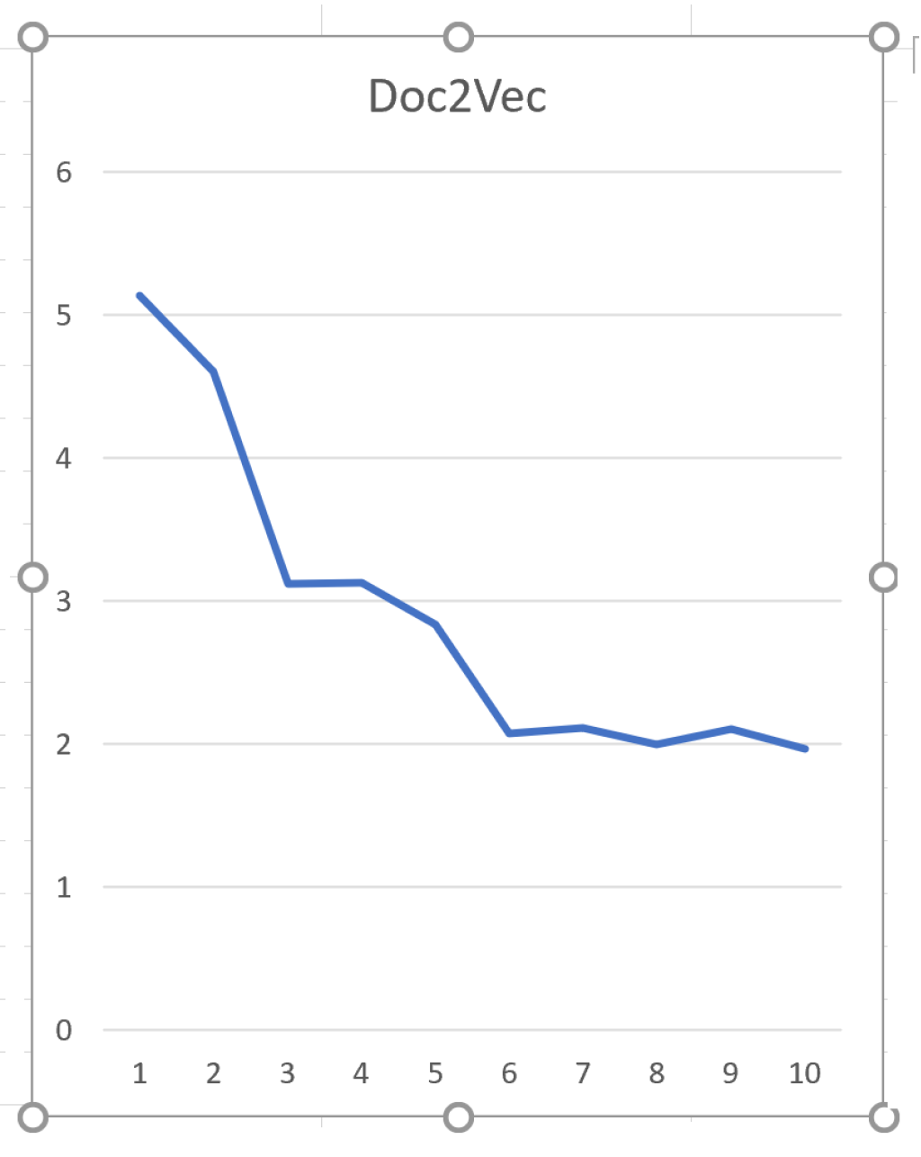
Result: Doc2Vec
Start point indicates the training loss of the initialized model, while the end point indicates the final training loss showed our expectations were not fully meet.

Slide 25
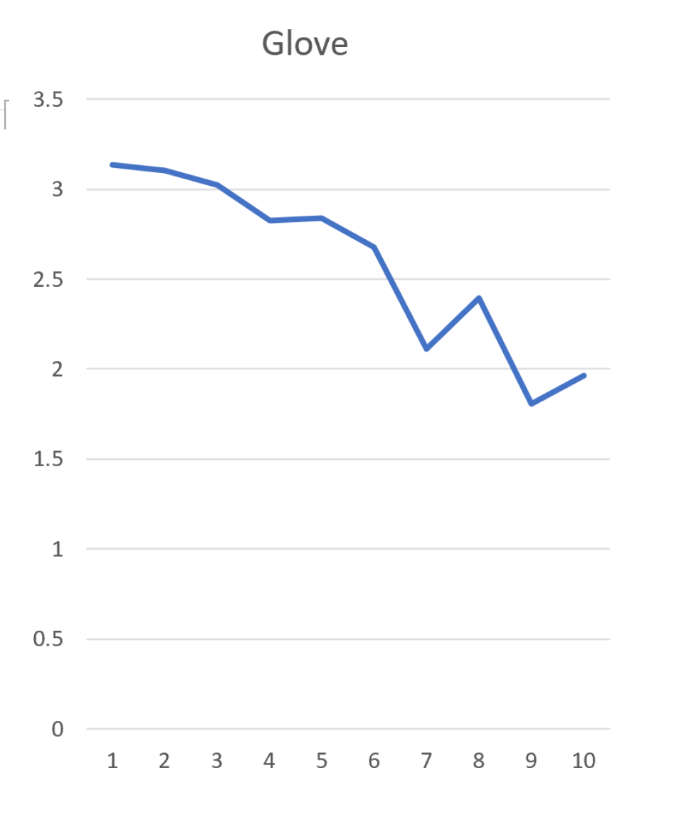
Result: Glove
It is observed that the losses are still quite high but were not reducing indicating more training data might produce a better result.

Slide 26
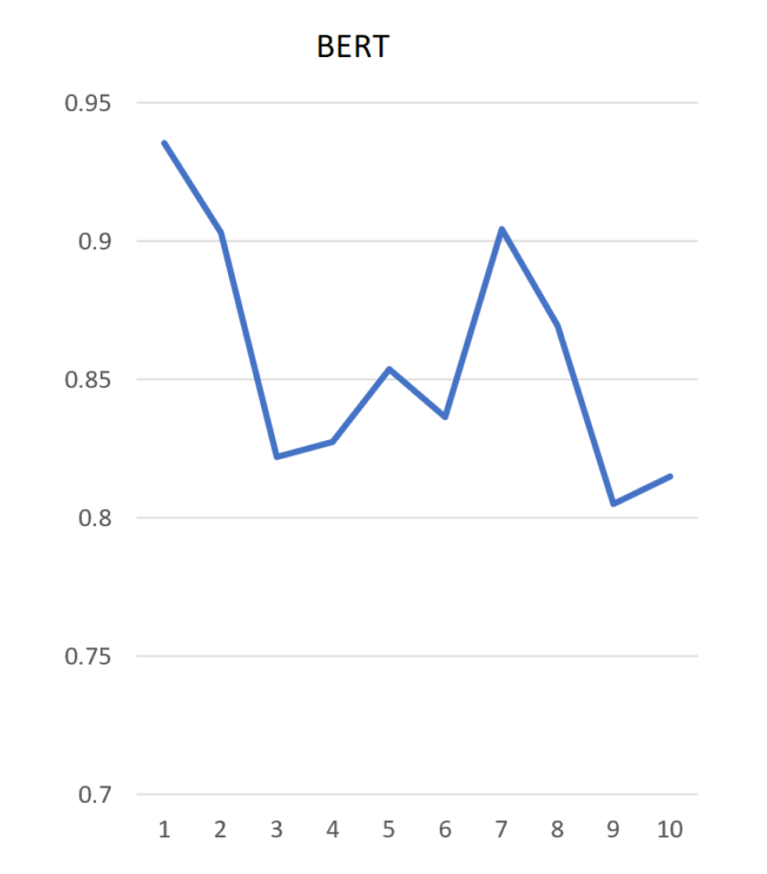
Result: BERT
Here since we were only Fine Turning, we expected the Loss to be quite low. It is observed that the losses are still quite high but were not reducing indicating more training data might produce a better result.

Slide 27
Conclusion
This is by no means an exhaustive list of pretrained NLP models hence we considered some of the most popular models based on our opinion.
The task was very challenging as it entailed training several models with some of the libraries deprecating but observing how they performed was interesting as such were plotted.
Though not shown yet as we were not able to plot the Davies-Boulding index, but just inspecting the results while training we can opine that the higher the dimensions used the better the result expect for BERT and that probably was because we only fine-turned it.

